Slide 1
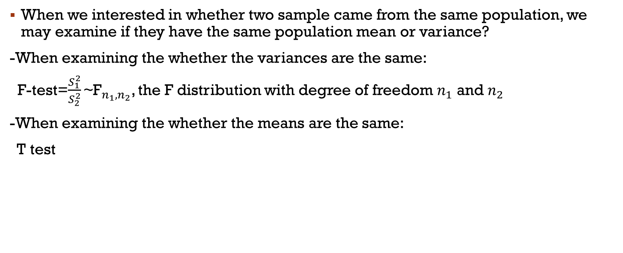
Fisher exact test
When we interested in whether two sample came from the same population, we may examine if they have the same population mean or variance?
-When examining the whether the variances are the same:
F-test=$\frac{S_{1}^{2}}{S_{2}^{2}}{\text{\sim }\text{F}}_{n_{1},n_{2}}$, the F distribution with degree of freedom $n_{1}$ and $n_{2}$
-When examining the whether the means are the same:
T test

Slide 2
Fisher exact test
If there are extreme values or violations of the normality assumption for the data, then the Fisher’s exact test may be more suitable for determining whether two samples come from the same population.

Slide 3
Fisher exact test
Consider there a 2X2 table with n<20.

Slide 4
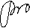
Fisher exact test

Slide 5
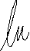
Fisher exact test

Slide 6
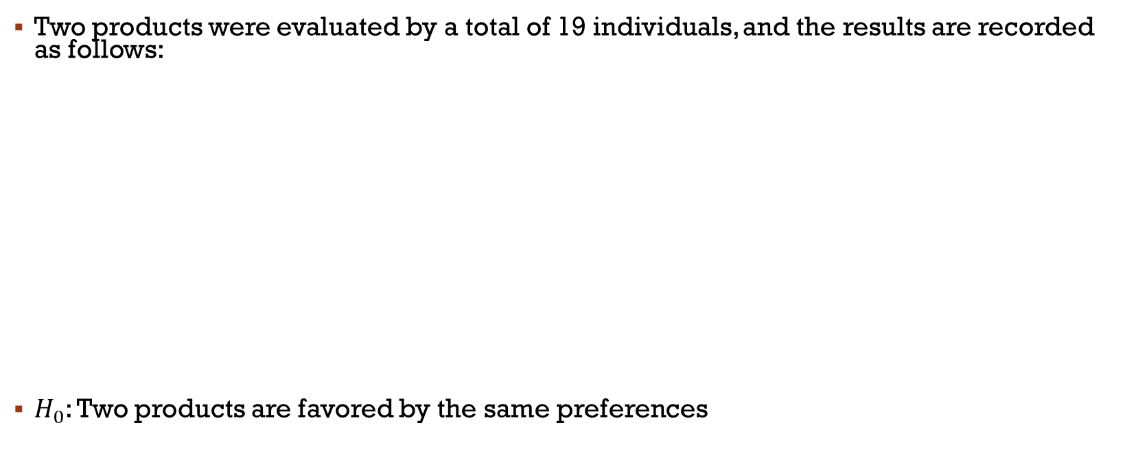
Fisher exact test
Two products were evaluated by a total of 19 individuals, and the results are recorded as follows:
$H_{0}$: Two products are favored by the same preferences

Slide 7
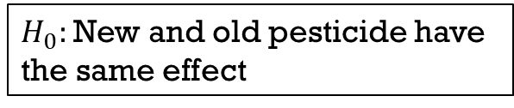
Fisher exact test
Drug manufacturers claim they have developed a new pesticide that is more powerful than the old ones
$H_{0}:$ New and old pesticide have the same effect

Slide 8
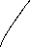
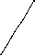
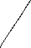
Fisher exact test
When $n≥$20

Slide 9
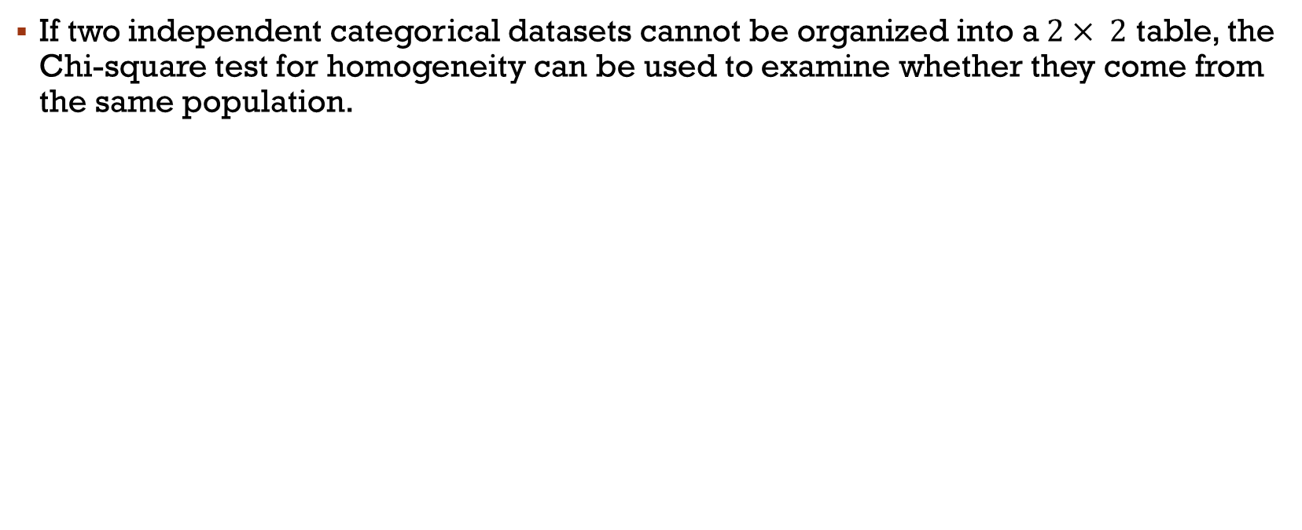
Chi-square of homogeneity
If two independent categorical datasets cannot be organized into a$2× 2$ table, the Chi-square test for homogeneity can be used to examine whether they come from the same population.

Slide 10
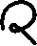
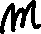
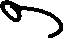
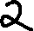
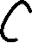
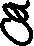

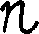

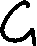
Chi-square of homogeneity

Slide 11


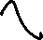
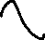


Chi-square of homogeneity

Slide 12

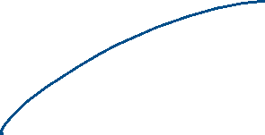
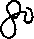
Chi-square of homogeneity
If we are wondering whether males with higher body weight have a higher heart rate than those with normal weight.

Slide 13
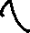




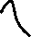






Chi-square of homogeneity

Slide 14

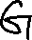
Chi-square of homogeneity
Small sample correction:
Under the small sample Wilks proposed a statistics obtained from the likelihood ratio approach:

Slide 15



Chi-square of homogeneity
ㄑIf we are interested in determining whether the number of individuals who violate traffic laws differs between those over and under the age of 25, we can analyze the data as follows

Slide 16










Chi-square of homogeneity
ㄑIf we are interested in determining whether the number of individuals who violate traffic laws differs between those over and under the age of 25, we can analyze the data as follows

Slide 17
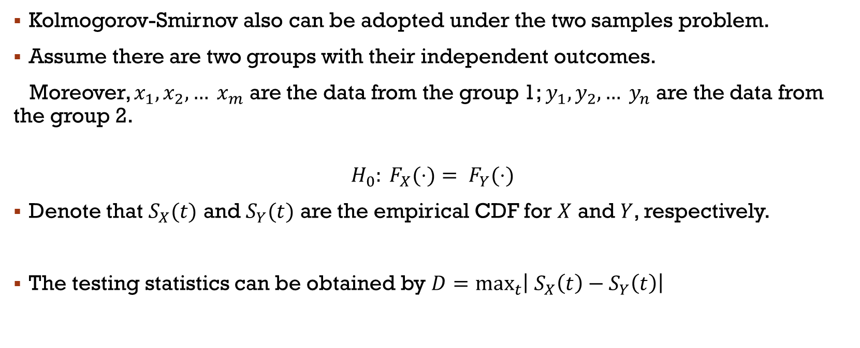
Kolmogorov-Smirnov
Kolmogorov-Smirnov also can be adopted under the two samples problem.
Assume there are two groups with their independent outcomes.
Moreover, $x_{1}, x_{2},… x_{m}$ are the data from the group 1; $y_{1}, y_{2},… y_{n}$ are the data from the group 2.
$$H_{0}: F_{X}(⋅)= F_{Y}(⋅)$$
Denote that $S_{X}(t)$ and $S_{Y}(t)$ are the empirical CDF for $X$ and $Y$, respectively.
The testing statistics can be obtained by $D=\max_{t}\left| S_{X}\left(t\right)−S_{Y}\left(t\right)\right|$

Slide 18


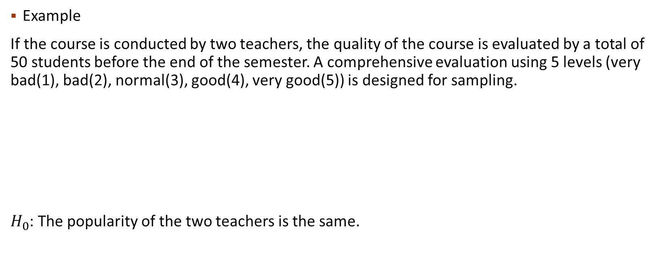
Kolmogorov-Smirnov
Example
If the course is conducted by two teachers, the quality of the course is evaluated by a total of 50 students before the end of the semester. A comprehensive evaluation using 5 levels (very bad(1), bad(2), normal(3), good(4), very good(5)) is designed for sampling.
$H_{0}$: The popularity of the two teachers is the same.

Slide 19









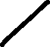






Kolmogorov-Smirnov

Slide 20
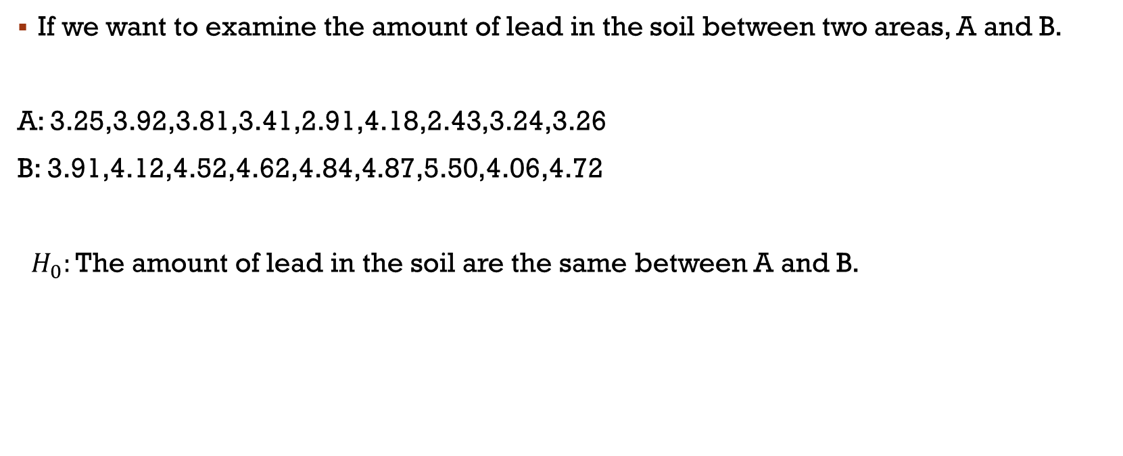
Kolmogorov-Smirnov
If we want to examine the amount of lead in the soil between two areas, A and B.
A: 3.25,3.92,3.81,3.41,2.91,4.18,2.43,3.24,3.26
B: 3.91,4.12,4.52,4.62,4.84,4.87,5.50,4.06,4.72
$H_{0}:$The amount of lead in the soil are the same between A and B.

Slide 21




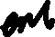








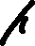


Kolmogorov-Smirnov

Slide 22
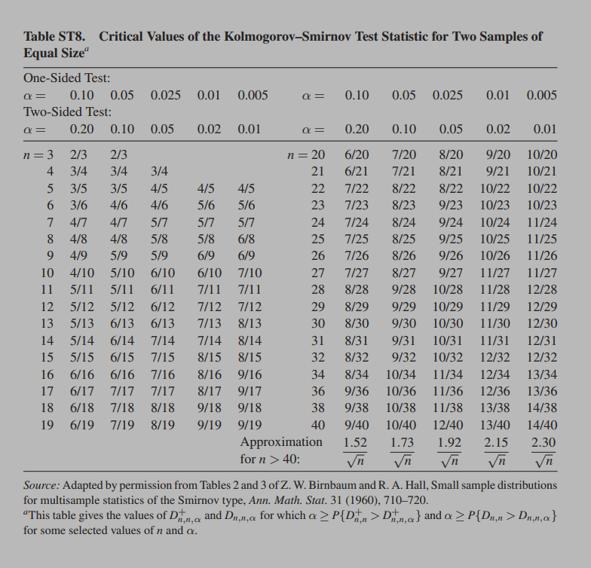

Slide 23
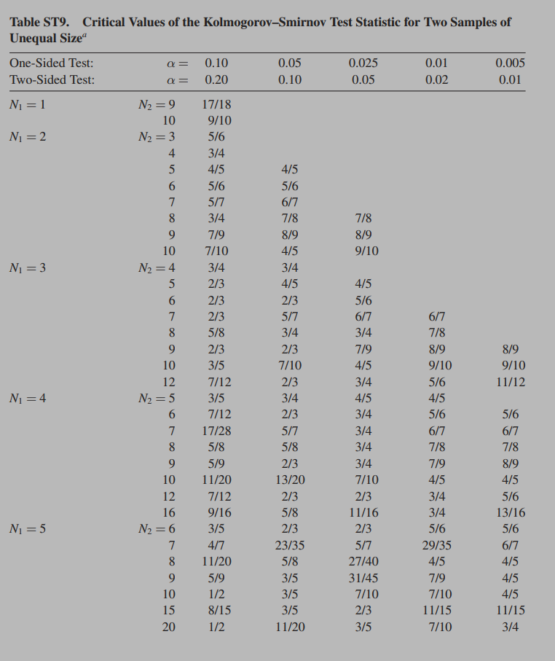

Slide 24
